Slide 1


Tutorial week 6
EE469/EE669/EE869/EE969
Module Introduction
carmine.clemente@strath.ac.uk

Slide 2
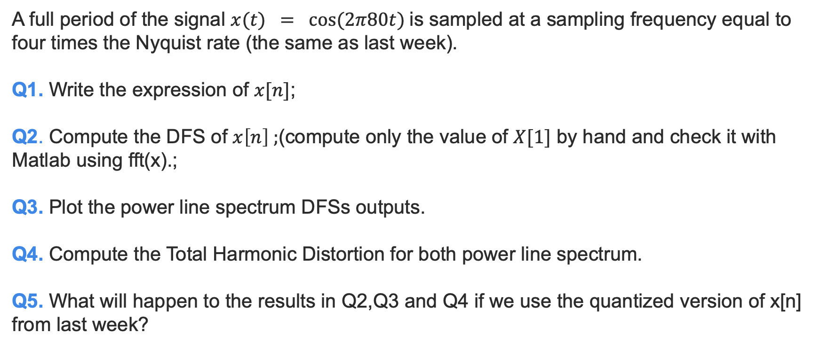
Question
A full period of the signal $x(t) = cos⁡(2π80t)$is sampled at a sampling frequency equal to four times the Nyquist rate (the same as last week).
Q1. Write the expression of $x[n]$;
Q2. Compute the DFS of $x\left[n\right] ;$(compute only the value of $X[1]$ by hand and check it with Matlab using fft(x).;
Q3. Plot the power line spectrum DFSs outputs.
Q4. Compute the Total Harmonic Distortion for both power line spectrum.
Q5. What will happen to the results in Q2,Q3 and Q4 if we use the quantized version of x[n] from last week?

Slide 3
X THE PLACE OF USEFUL LEARNING

